Slide 1
Sockets

Slide 2
Background
Originated with ARPANET in 1971
Became part of Berkeley Software Distribution in 1983
Became common for network programming in the 1990’s with the internet.
Commonly used for client server applications
Over years, protocols have evolved but underlying Socket API has not changed.
Notes:
ARPANET The Advanced Research Projects Agency Network

Slide 3
Where sockets fit in to the communications model.
Application
Sockets
Transport layer
Network
Physical
Notes:
Sockets are not a layer
The API fist in-between application and transport but can also bypass transport for direct connection to network.

Slide 4
What is a socket
A socket is a combination of:
IP address
Port number
The IP Address is the logical identification of a device
The port is the virtual Identifier for a service or application

Slide 5

We use the analogy of “sockets” to describe a connection between 2 devices, one plugging in (or connecting) to the other. General, the socket is owned by a computer systems with the wire being the virtual connection between the computers

Slide 6
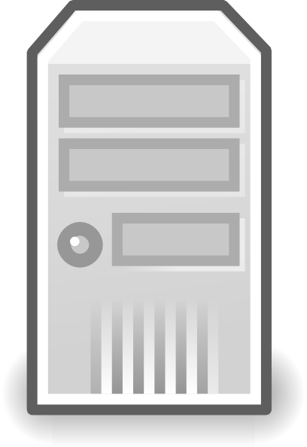

Ports on a server.
On its own, a port number is not unique. We can have the same numbered port used by Tcp/Ip and UDP protocols.
The combination of port number, local IP address and protocol defines the socket.
So we can have many applications using many sockets
And one application using many sockets
(note that we can have several applications using one port but this could confuse our programs as there will be no way to determine which application should receive the incoming data).
A socket is not a connection. It is an end point to a specific connection.

Slide 7
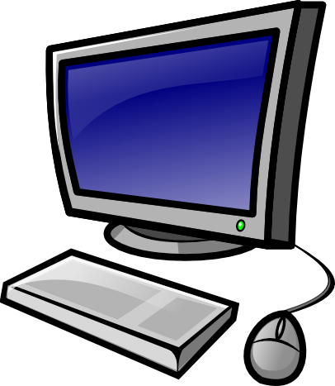

The socket can be connected to by many client connections.
Each combination of client IP and port, makes a connection to a socket.
So a servers socket can be bound to by several clients, making several different connections to one sockets
Connecting local and remote sockets are Socket Pairs

Slide 8

My brain!

Slide 9
Shush, its ok. Have a relaxing picture of a parrot.

Slide 10
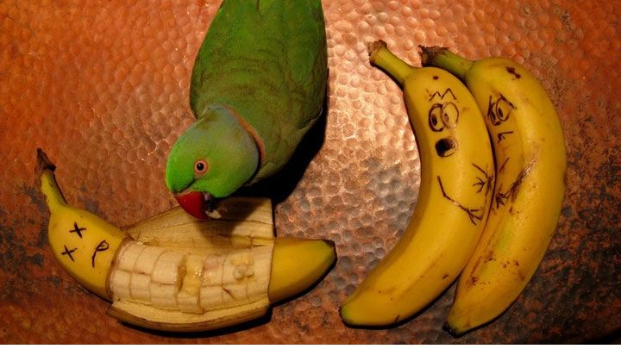

Slide 11
Moving on!

Slide 12
Socket Types

Slide 13
Socket Types
Datagram sockets
Stream sockets
Raw sockets
Other
Rdm
Seqpacket

Slide 14
Datagram sockets
Supports Datagrams (obviously), used with UDP.
Connectionless. We don’t need to negotiate a dedicated connection to a client or server. Just send and hope.
Each packet sent is individual addressed and routed.
Order and reliability are not guaranteed
In order to receive datagram packets, the socket should be bound to a “wildcard” address. IE a way to accepting anything.

Slide 15
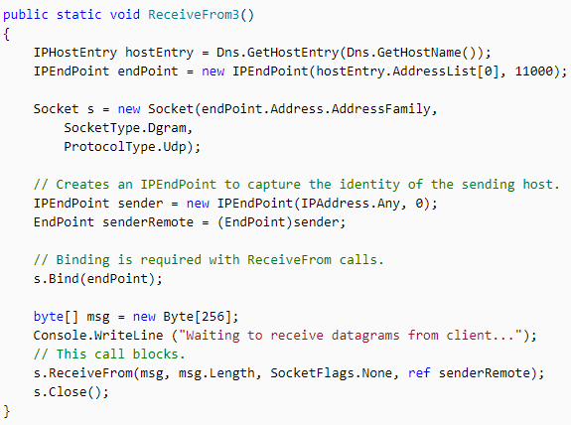
C# example
See https://docs.microsoft.com/en-us/dotnet/api/system.net.sockets.socket.receivefrom?view=netframework-4.7.2
NOTE: you can not multicast like this, across the internet.
You need special, multicast enabled hardware to facilitate this. Should work fine in private network though. (be carful, if you try this in the Uni you might end up spamming the network and the IT dept Might take offence to it. Try it at home where no one cares).

Slide 16
Stream sockets
Connection orientated
Sends Sequenced and unique data
Well defined mechanisms for creating, destroying connections and detecting errors
Reliable
Typically uses TCP
Data block are fixed size. Data block bounders is not respected.

Slide 17
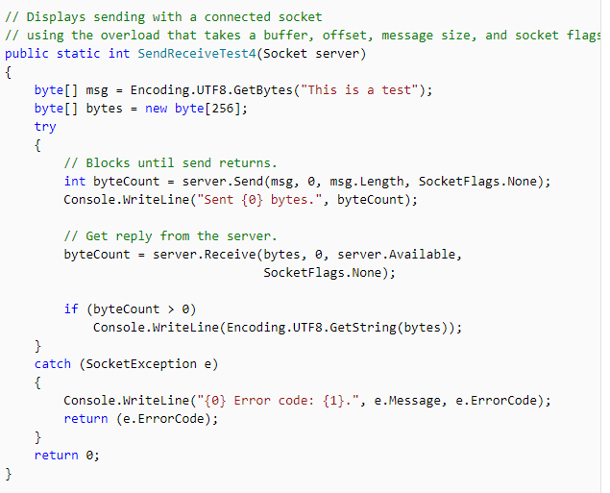

C# Example
See https://docs.microsoft.com/en-us/dotnet/api/system.net.sockets.socket.receive?view=netframework-4.7.2

Slide 18
Raw sockets
Allows direct sending and receiving of IP packets
Transport layer formatting (its called raw for a reason)
You either have to wrap the payload yourself or don’t. its up to you.
you are wholly responsible, so all errors are almost guaranteed to be PICNIC’s.
Probably not a good idea to use this unless you know what you are doing
Good way to experiment with your own transport layer protocols though.
Micro$oft limited raw sockets support due to security concerns.
Notes:
PICNIC
Problem In Chain Not In Computer
Used in:
Internet Group Management Protocol (IGMPv4)
Open Shortest Path First (OSPF)
Internet Control Message Protocol (ICMP) Ping utility uses it.
Nmap (Network Mapper)

Slide 19
Other Sockets
Not really useful for us
Implemented using other transport protocols
SNA
UDS
Notes:
System Network Architecture SNA IBMs proprietary architecture for networking. Created in 1974.
Unix domain sockets UDS or IPC sockets (Inter-Process Communication sockets) used to transmit data between processes on the same host operating system.

Slide 20
Rdm Sockets
Reliable Delivery Message
Similar to Datagram sockets but provide additional reliable datagram delivery.

Slide 21
Seqpacket
Sequenced packet socket
Similar to stream sockets
Maintains data boundaries. It knows how big you message is.

Slide 22
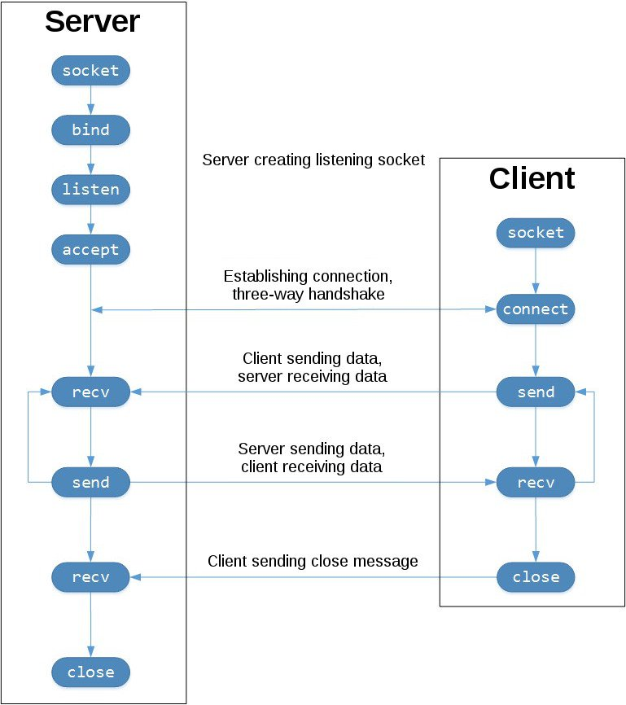
Whole Process

Slide 23
Questions?

Slide 24
Look in to asynchronous sockets

Slide 25
Convert your applications to use UDP

Slide 26

Quit Procrastinating
And work on your code!

